Slide 1


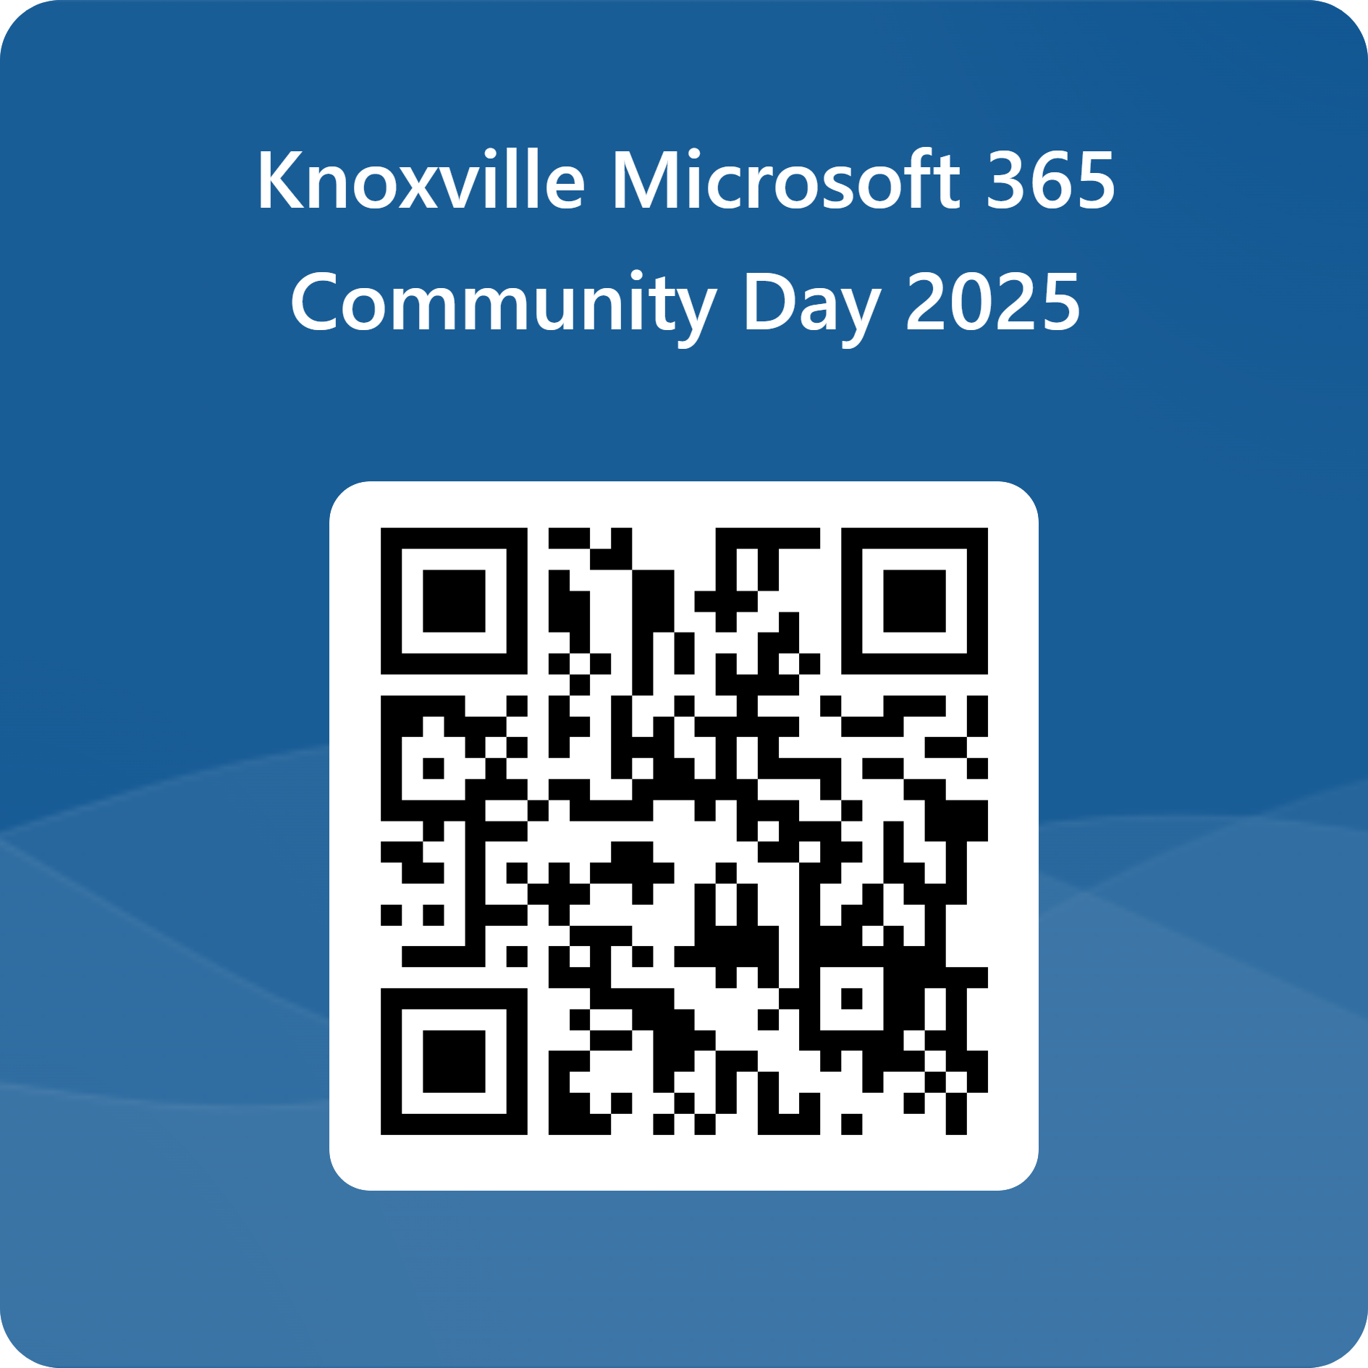








Knoxville Microsoft Community Days
Special Thanks to Our Sponsors
FEEDBACK
Thank You Valued Contributors!

Slide 2
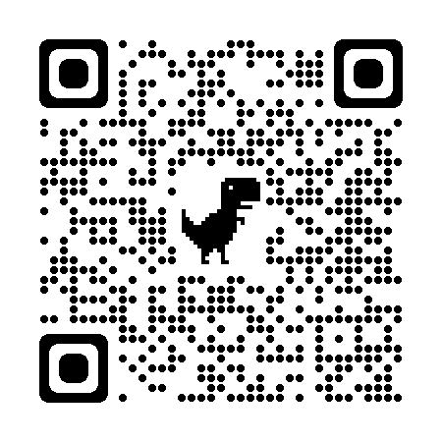



Power Platform for the IT Professional
Ross Boe
https://www.linkedin.com/in/ross-boe-ms-2b459b250/
https://github.com/polks71
https://trunorthdynamics.com/
Notes:
Ask questions about audience
How many are with an MSP? Internal IT shop? Student? Faculty? Other Power Platform, D365 person wondering how I will distill this down to 50 minutes?

Slide 3
Agenda
Power Platform and Dynamics 365.
Management
Licensing
Power Platform and AI
Scaling Up and Down the Enterprise
Low-code/No-Code/Pro-Code as First Class Citizens
Notes:
Remind that this conversation is going to be at a high level. I am happy to go in the weeds afterwards but to meet the goal of getting through this we need to stay pretty high level.

Slide 4




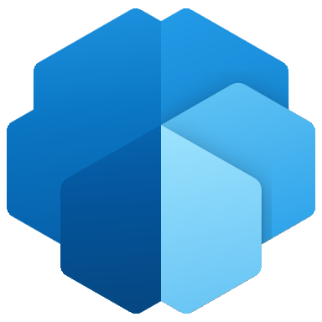

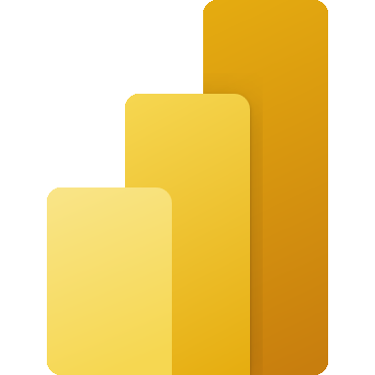


Copilot
Studio
Dataverse
Power Apps
AI Builder
Power
Automate
Power BI
Power FX
Power Pages
Notes:
When we talk about Power Platform these are the applications that are typically included in that conversation.
AI Builder – Use AI models to interpret images, documents, data, and take action.
Copilot Studio – build your own Copilots
Dataverse – Fully managed backend data storage, with a ton of additional features, file storage, audit, CosmoDB (NoSQL)
Power Apps – Canvas Apps and Model Driven Apps. Low Code/No Code app building
Power Automate – automation
Power BI – data visualizations , some ETL capabilities
Power FX – scripting language in Dataverse, Model Drive, and Canvas Apps
Power Pages – web pages, customer portals, shopping sites

Slide 5
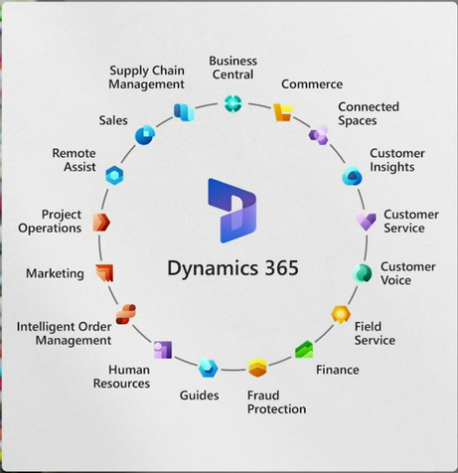

Slide 6
Dynamics 365 ≠ CRM
Dynamics 365 has a CRM

Slide 7
This is CRM

Slide 8
Managing the Power Platform
Notes:
We will walk through several slides leading up to the top 5 actions as an Admin you can take. You should do them now if you haven’t.

Slide 9
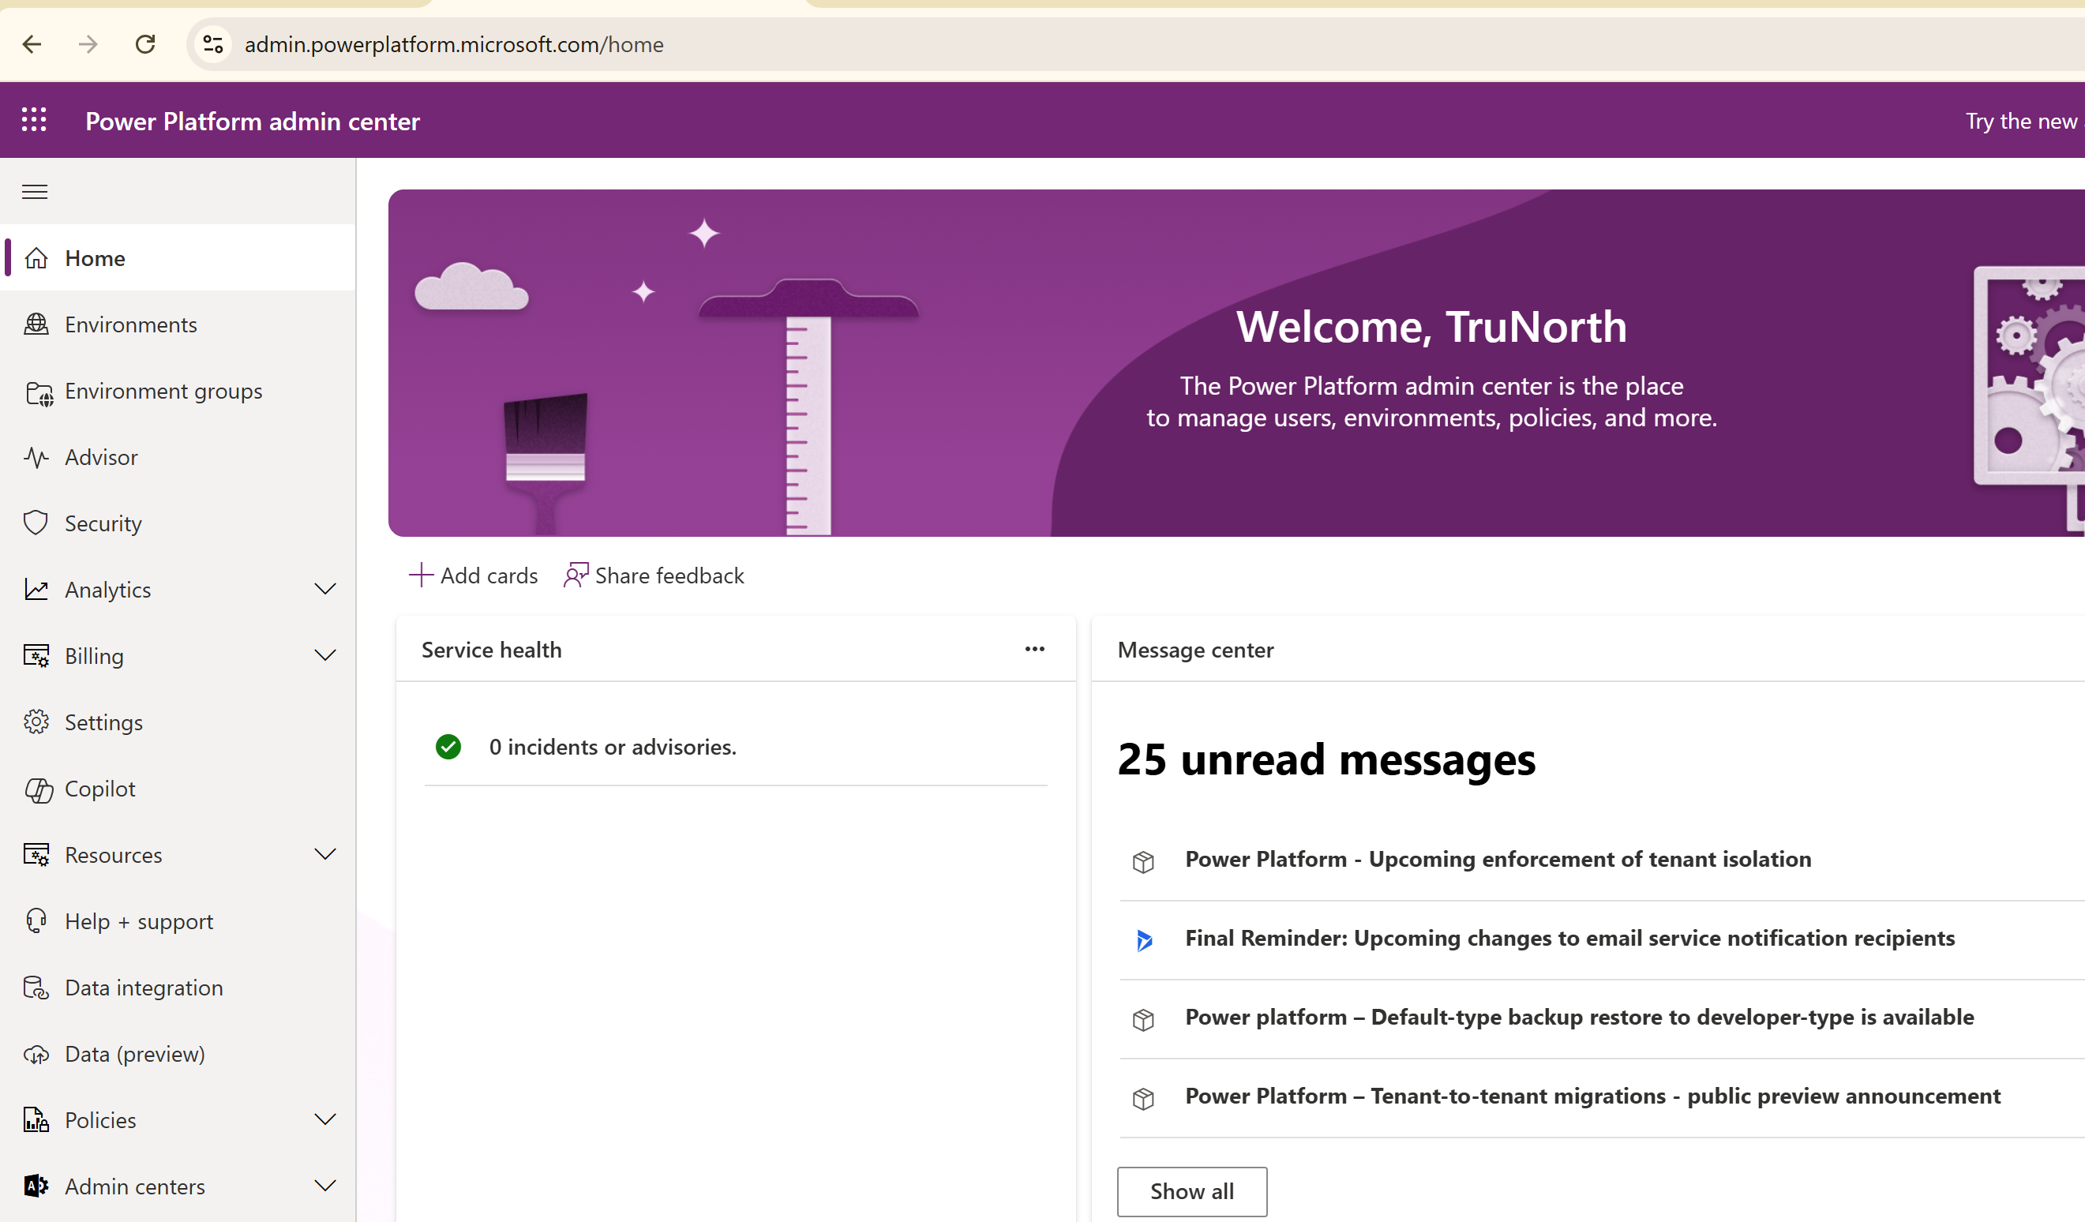

Slide 10
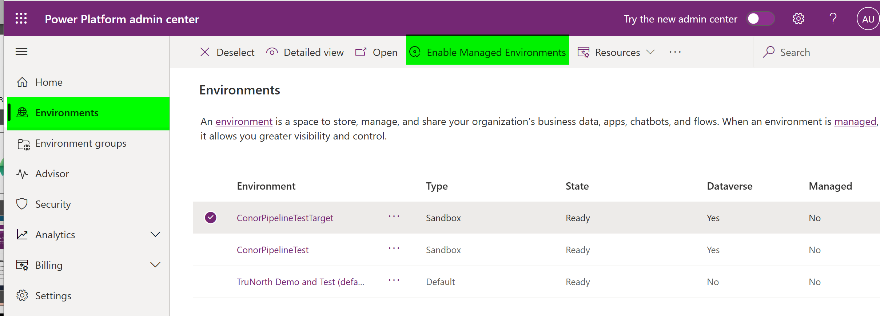
Environments
Notes:
Set defaults to enforce best practices and enhance security.

Slide 11
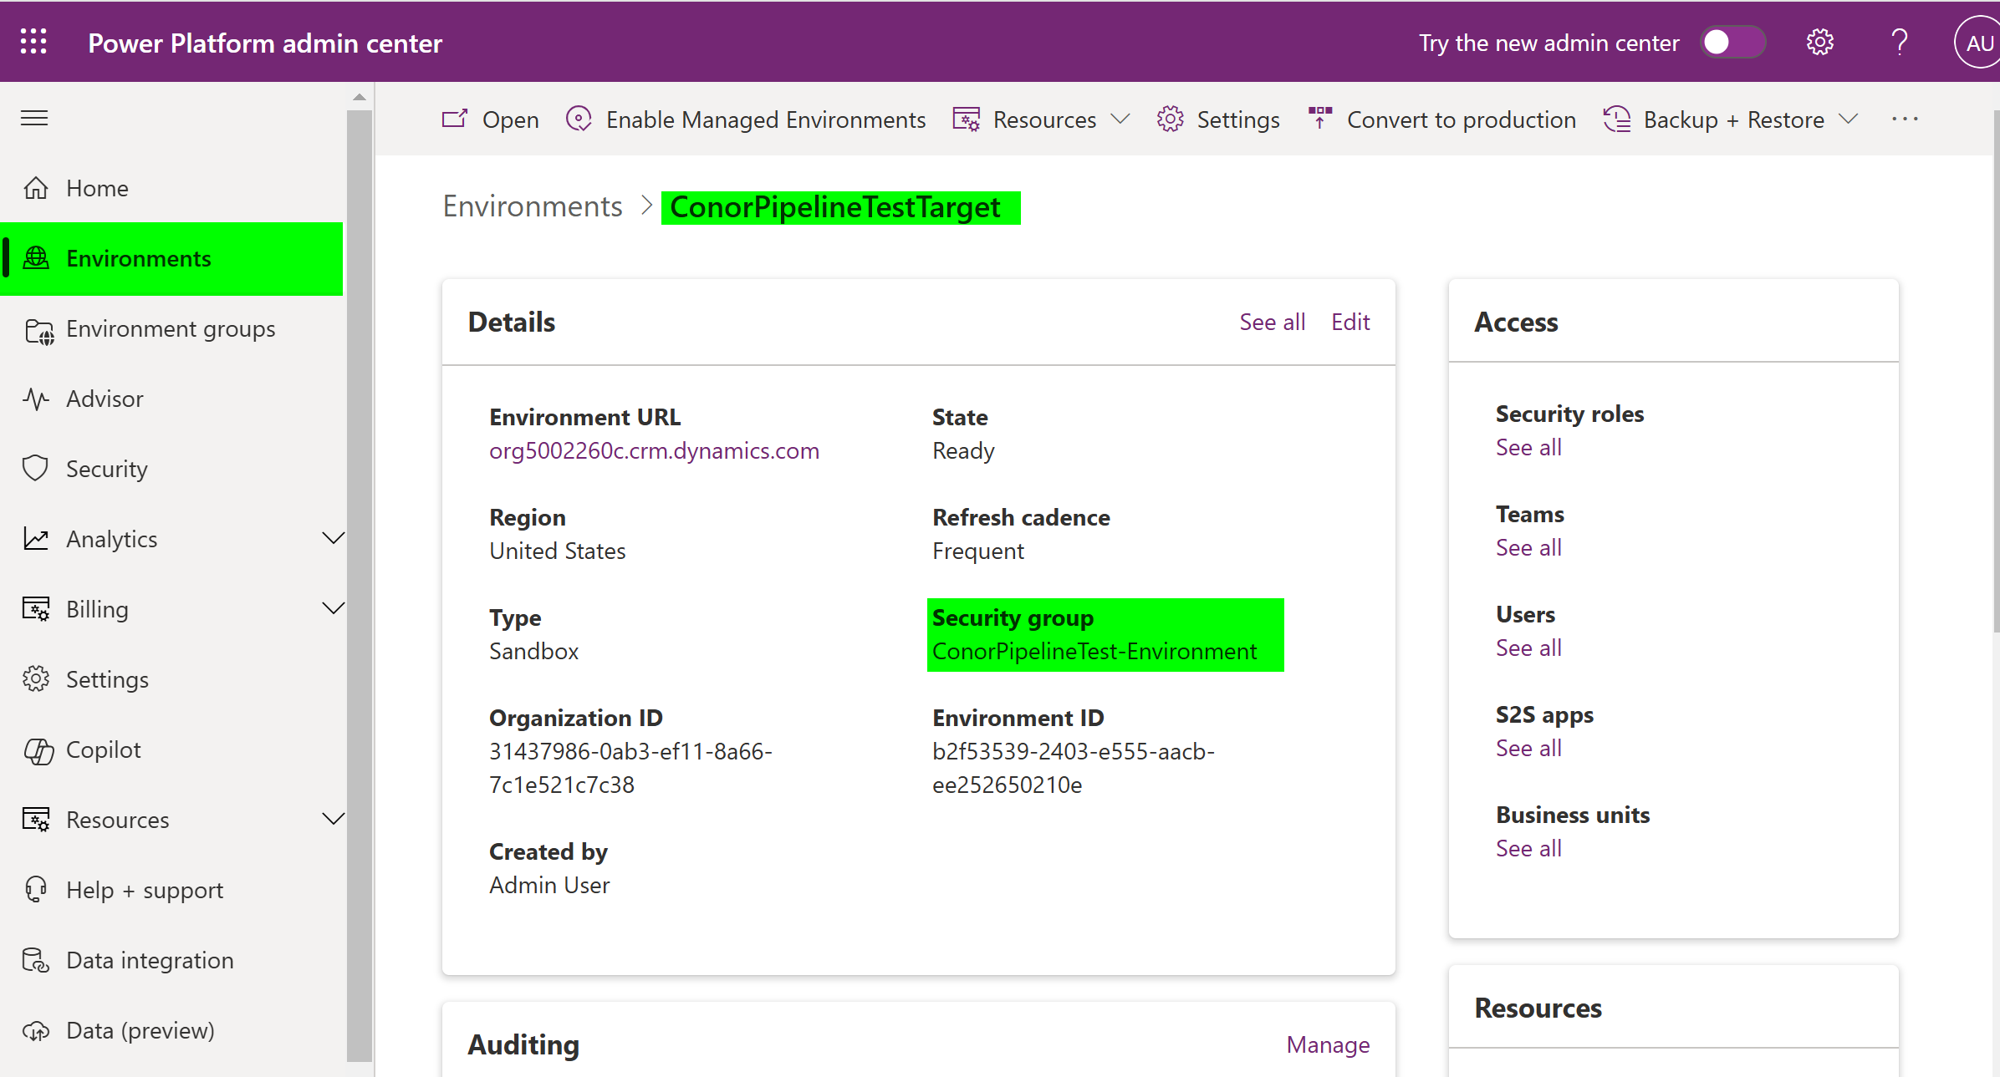
Environment Entra ID Security Groups
Notes:
The most basic level of security check. If the user is not in the Security Group they do not have access period.
Also user records are only created for users that are in the security group.
Use NDCDE as an example.

Slide 12
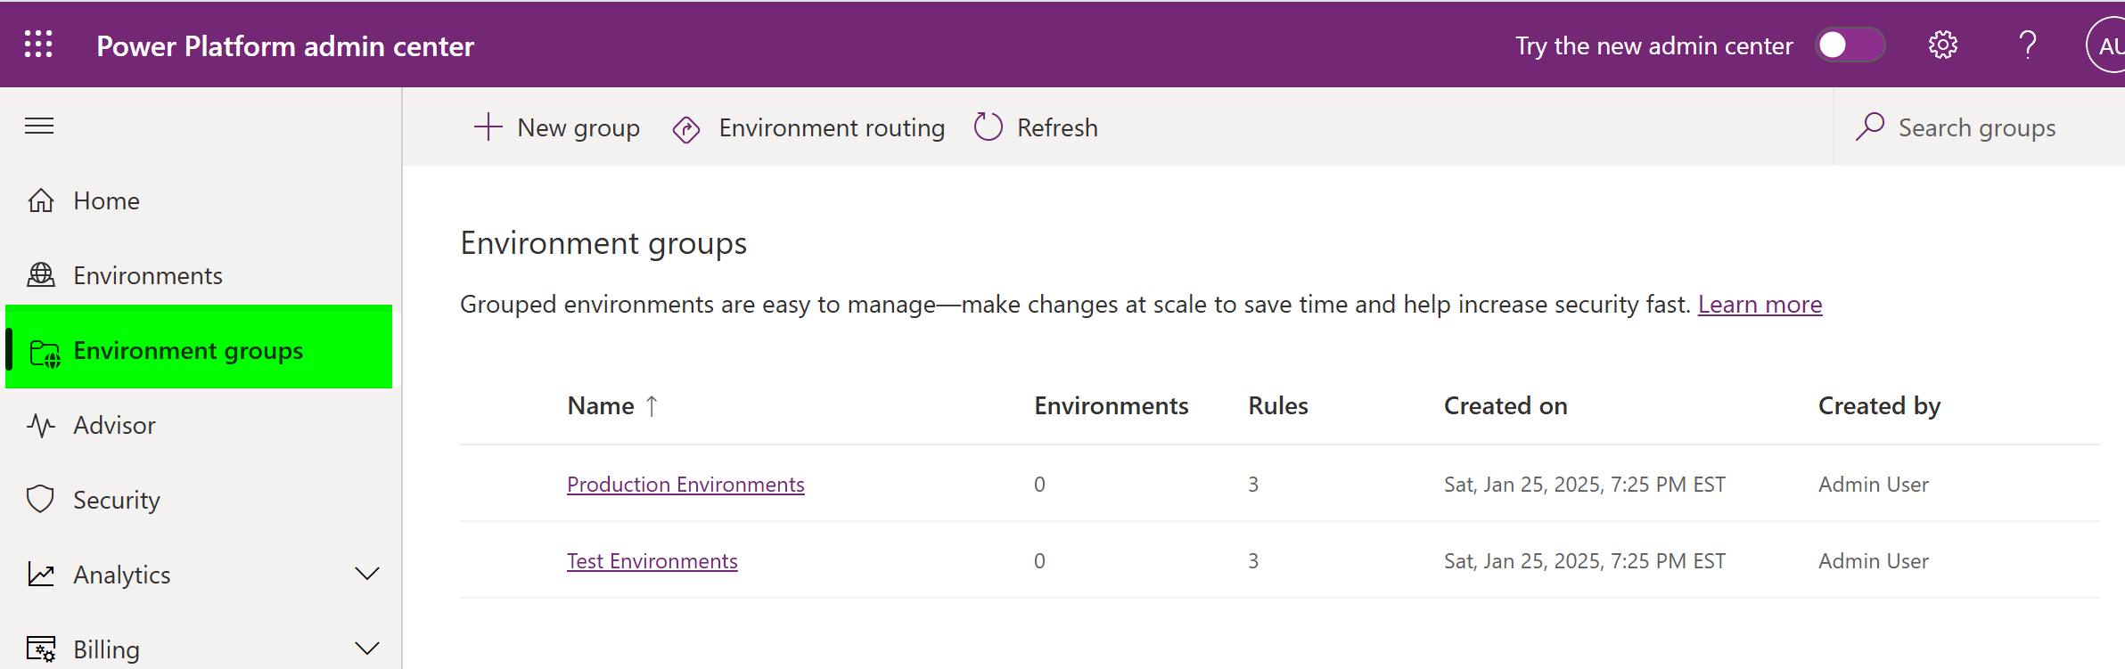
Environment Groups

Slide 13
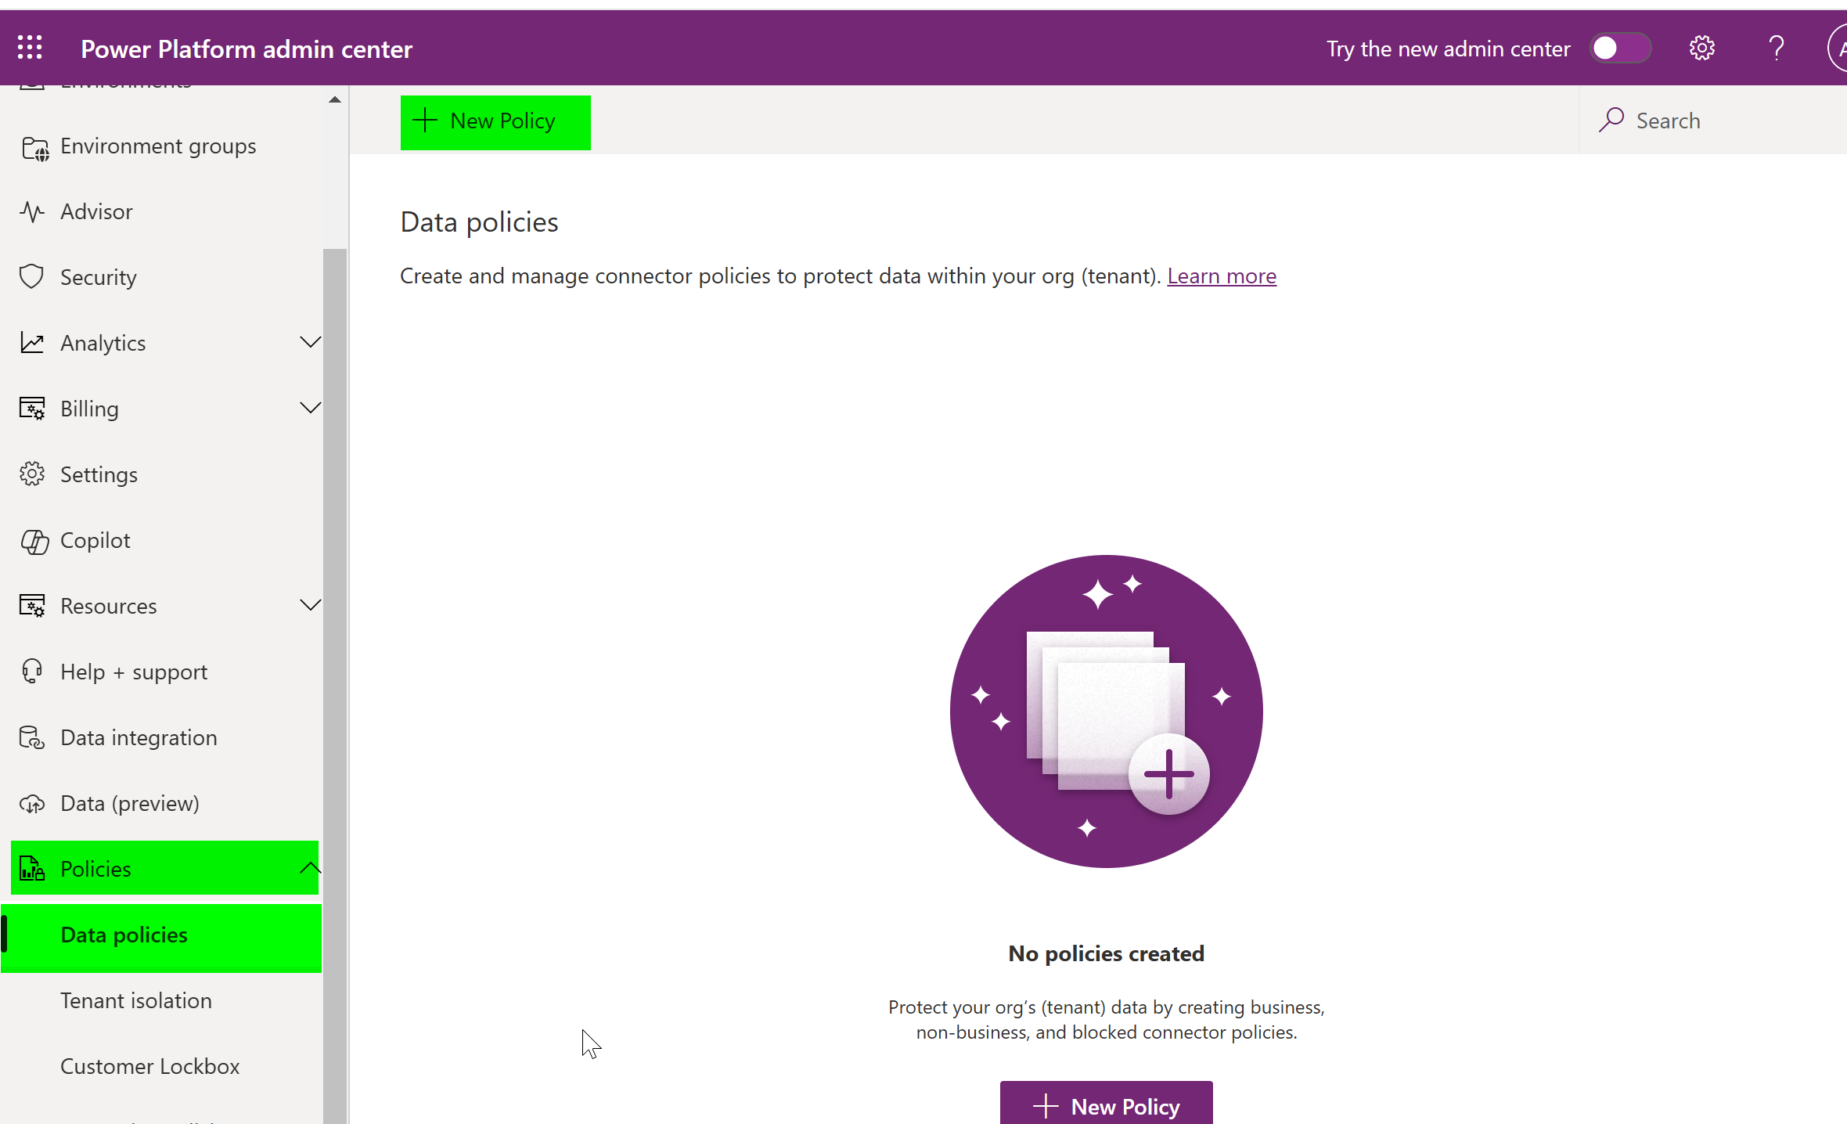
Data Policies
Notes:
Shows every single connector available in Power Platform. You can choose if they should be enabled or disabled.

Slide 14
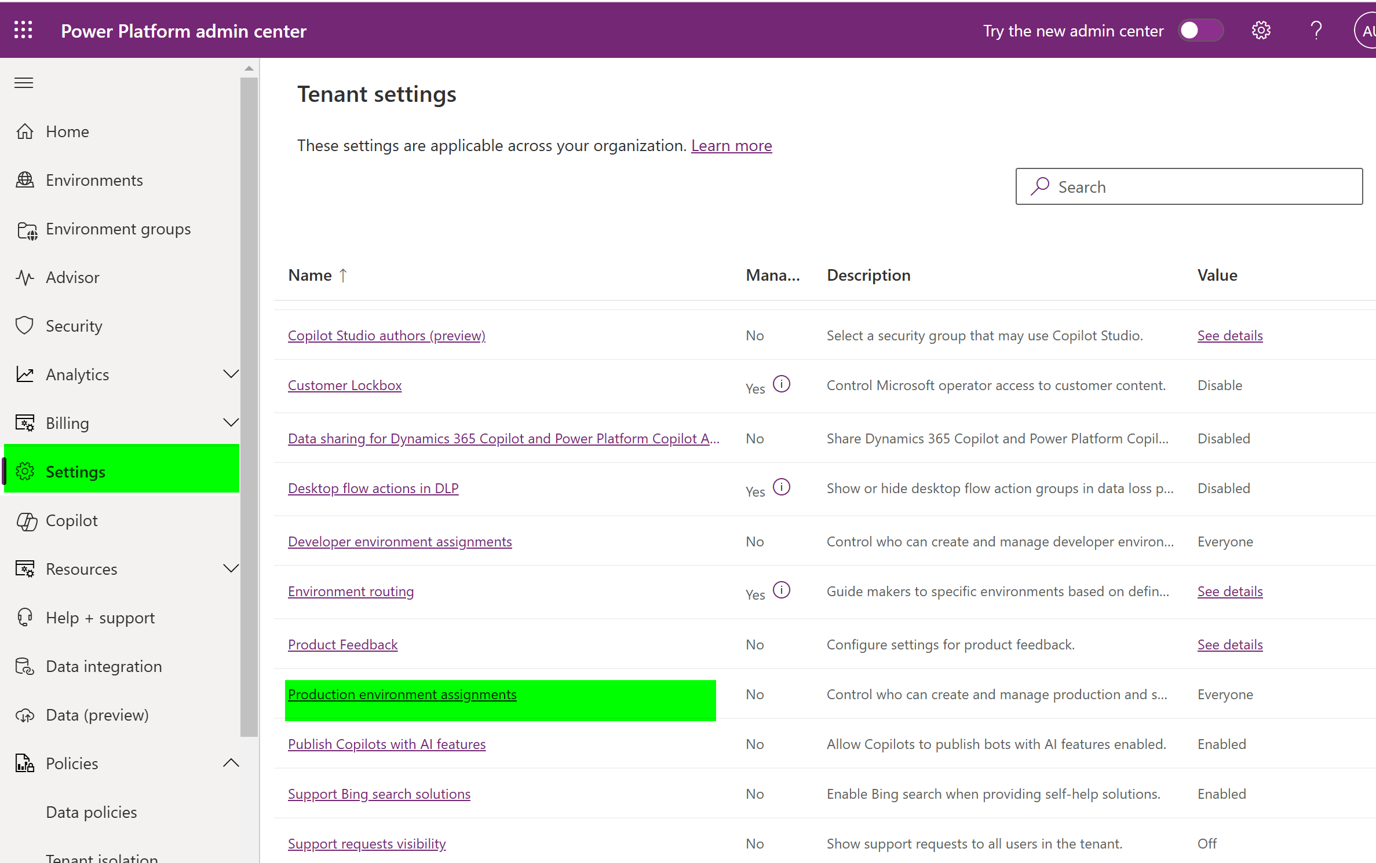
Settings – Environment Create
Notes:
Production Environments Assignments: Change to Yes. This prevents anyone but admins from creating environments. That allows you to create a process around environment creation.
Bonus: Enable one called Analytics. Enables the Advisor to give relatively good ideas to look at.

Slide 15
First 5 Actions
Set up Environment Groups
Enforce Managed Environments
Configure rules that make sense for needs.
Set up Entra ID Security Groups
Managed Environments
Enable for all environments.
Evaluate Rules
Backup Retention without Dynamics 365 Apps
Data Policies
Restrict unwanted connectors
Settings / “Production environment assignments”
Set so only admins can create environments

Slide 16
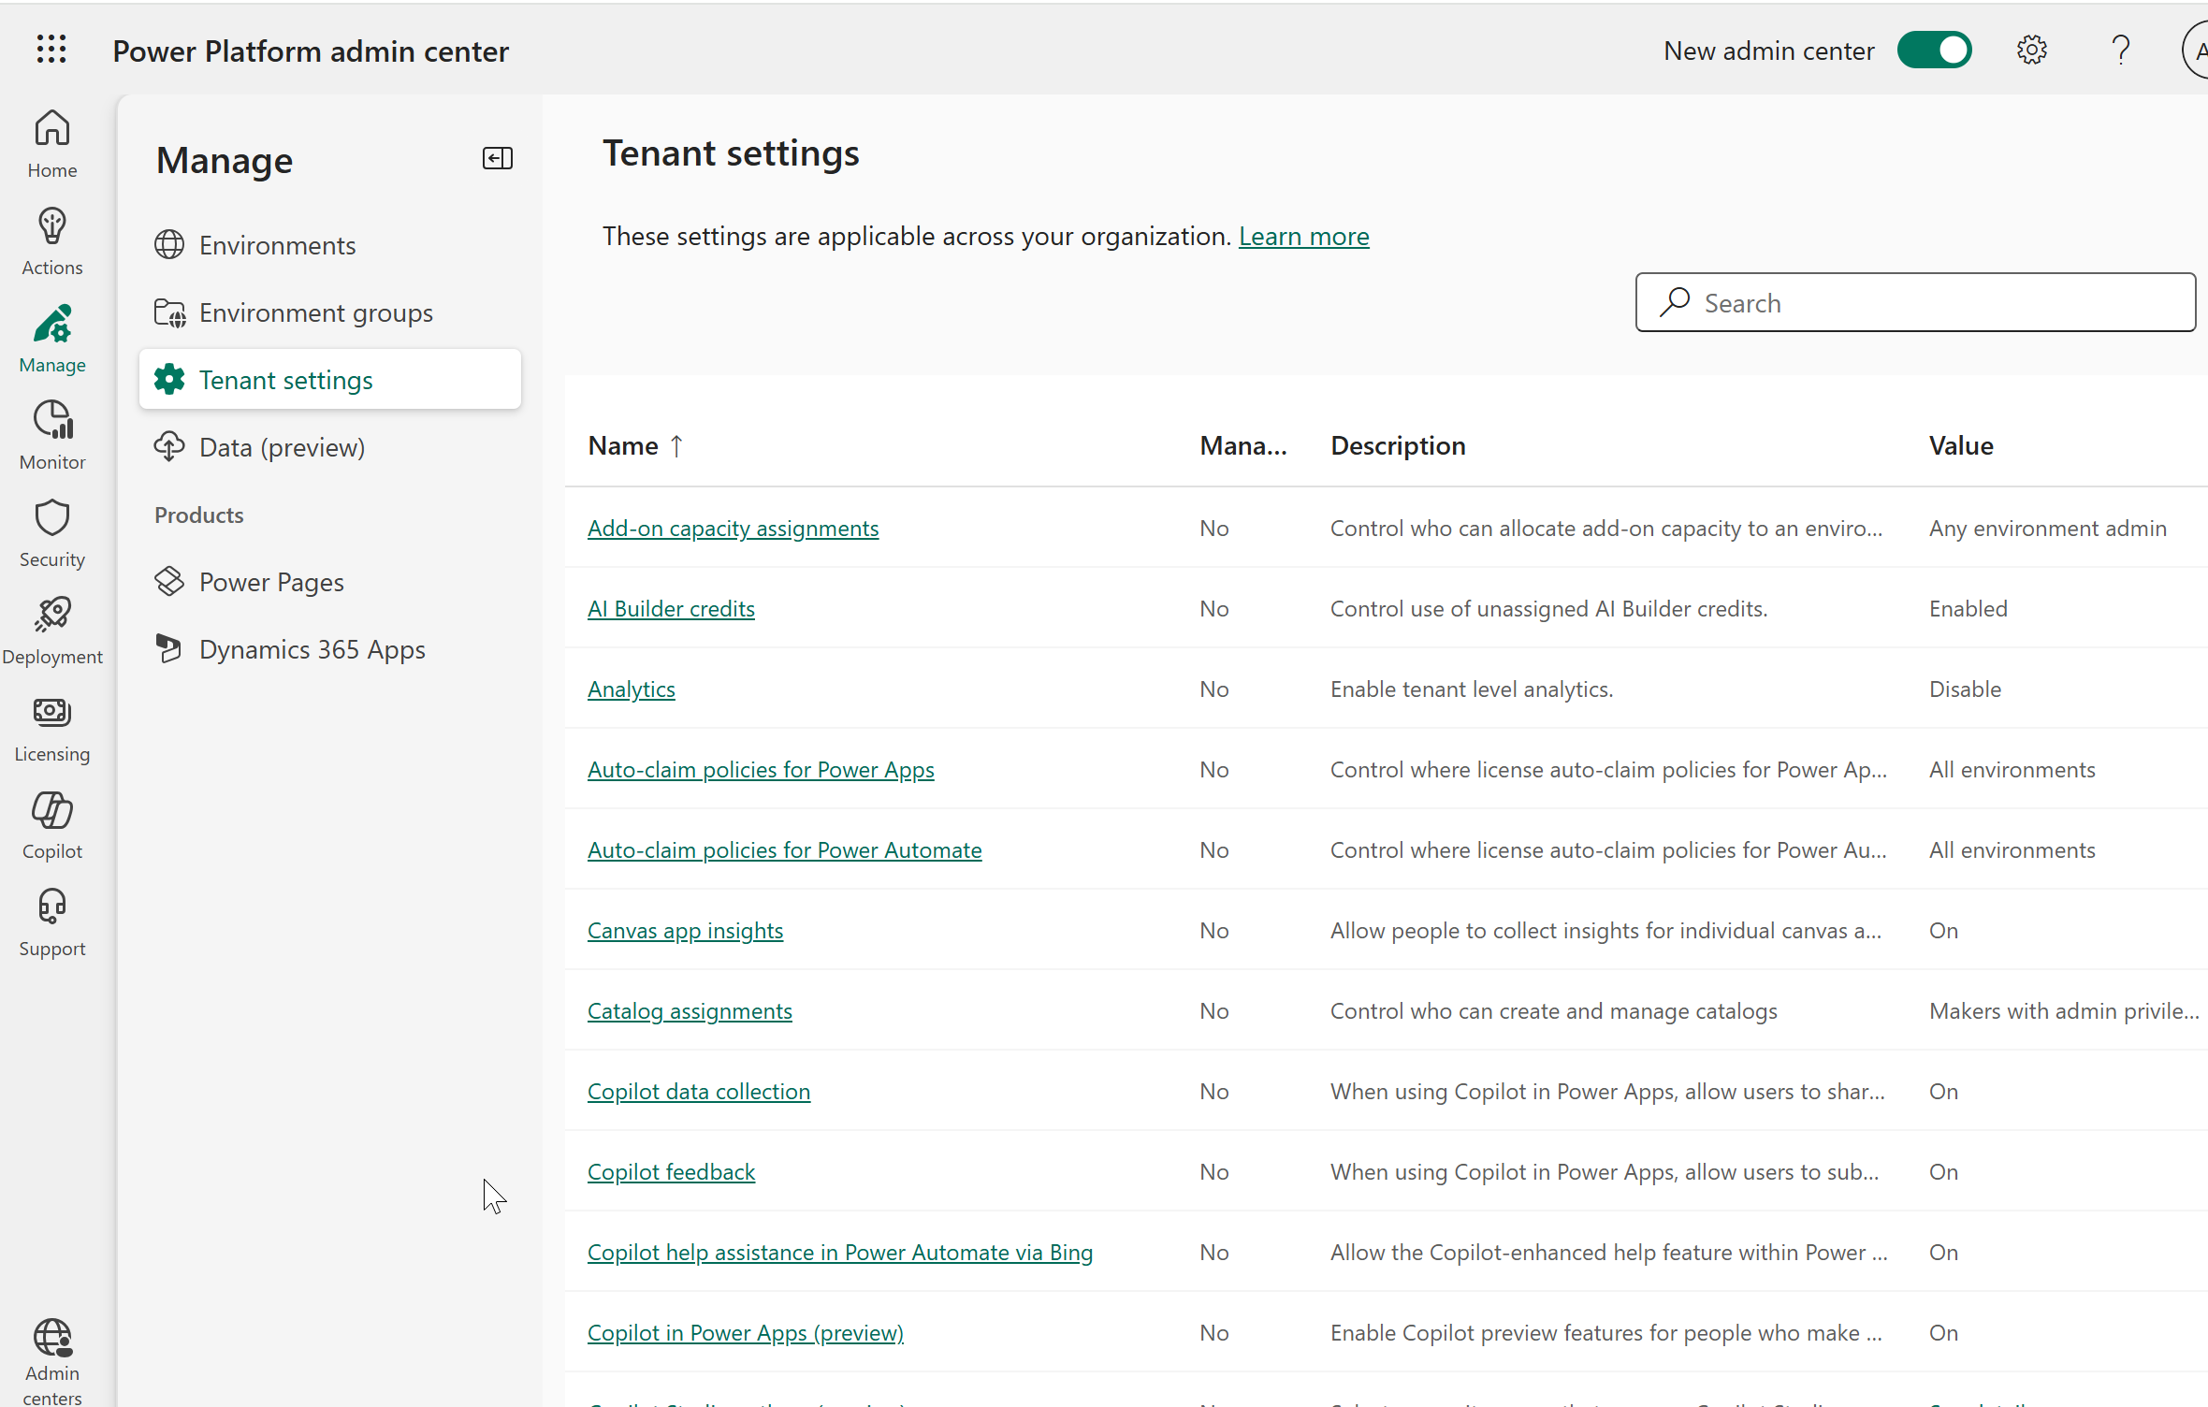

Slide 17
Power Platform and Dynamics 365 Backups
Power Platform / Dataverse
Production With Dynamics 365 : 28 Days
Production Without Dynamics 365 : 7 Days
All Others : 7 Days
Dynamics 365 Business Central
28 Days
Dynamics 365 Finance (and related)
28 Days

Slide 18
Improving the Backup Situation
Power Platform
Own Backup
Commvault
ArcServe
KeepIt
Business Central
Unlocked ER
Notes:
One of the challenges with BC is the throughput allowed with the API. In theory a backup can be completed but not guaranteed. MS allows an export 10 times a month, which is what Unlocked ER takes advantage of.
Power Platform backup solutions read data from the APIs and store it in different ways. Each solution has different features.

Slide 19
Where?
Power Platform
https://admin.powerplatform.com
Maker Portal
https://make.powerplatform.com
More admin available
Gear/Advance Settings
Dynamics 365 Business Central
https://businesscentral.dynamics.com/{tenant_id}/admin
Dynamics 365 Finance/Supply Chain/HR/
https://lcs.dynamics.com/v2
https://admin.powerplatform.com

Slide 20

Licensing
Notes:
We will walk through several slides leading up to the top 5 actions as an Admin you can take. You should do them now if you haven’t.

Slide 21
Licensing Guides are you Frenemies
Power Platform
https://go.microsoft.com/fwlink/?linkid=2085130
Power-Platform-Licensing-Guide-December-2024-PUB.pdf
Dynamics 365
https://go.microsoft.com/fwlink/?LinkId=866544&clcid=0x409
Dynamics-365-Licensing-Guide-January-2025.pdf

Slide 22
Type of License
Per User
Consumption
Pay as You Go

Slide 23
Per User
Purchase a license from Microsoft, Distributor, or Partner.
Multiple Environments
License Grants
Power Automate Events/Executions
Dataverse Capacity: Audit, File, Database.
Dynamics 365 Copilots
Attach License?

Slide 24
Consumption
Purchase X amount of Y per Z period.
Examples
Power Pages
Number of Logins
Number of Anonymous Uses
AI Builder
Service Credits
Copilot Studio
Number of messages with agents

Slide 25
Pay as You Go
Link to an Azure Subscription
Pay for consumption actually used instead
Examples:
Dynamics 365 Sales
If user logs into Dynamics 365 Sales in the Month the license fee is charged.
Copilot Studio
Messages consumption paid as used. (Combine with pre-purchased capacity)

Slide 26
Mulitplexing
If a user automatically receives information from Power Platform/Dynamics 365 they need a license.
Automation is the key
Notes:
Business Central and Teams is an Exception. License not required to make BC reports available in Teams.
This is not unique to Power Platform/Dataverse, SQL Server is this way

Slide 27
Power Platform and AI
Notes:
We will walk through several slides leading up to the top 5 actions as an Admin you can take. You should do them now if you haven’t.

Slide 28
Copilots
Copilot for Sales
Sales Copilot
Customer Service Copilot
Project Operations Copilots
Business Central Copilot
Field Service Copilots
Finance and Operation Copilots
Power Platform Maker Copilots
Notes:
Note about Copilot in Dynamics 365.
I attended the Tampa Dynamics User Group sessions. A Microsoft Field Service engineer said Copilot is going to be the user interface of choice.

Slide 29
Scaling Up and Down the Enterprise

Slide 30
Enterprise Adoption
95%+ of Fortune 500 Companies use Power Platform
https://www.microsoft.com/en-us/power-platform/blog/2020/06/16/imagine-build-and-deploy-solutions-with-microsoft-power-platform/

Slide 31
SMB Adoption
There are no concrete published figures.
Numerous Dynamics Partners consistently collaborate with small to medium-sized businesses.
48 million Monthly Active Users
An increase from 20 million in 2022.
https://www.syskit.com/blog/microsoft-power-platform-in-numbers/
https://www.linkedin.com/pulse/microsoft-business-applications-numbers-july-2022-inspire-fratello/

Slide 32
No-Code Low-Code Pro-Code as First Class Citizens

Slide 33
Who?
No-code
Business end user or power user
Low-Code
Able to write some light scripts. PowerFX
Create Power Automate Flows
Custom Connectors
Pro-Code
Professional developer
Lives and breathes code

Slide 34
Consume API With Canvas App
Pro-Code
Low-Code
No-Code
Create API
Create Postman Export
Create Custom Connector
Consume API with Canvas App

Slide 35
Dataverse Virtual Tables
Pro-Code
Low-Code
No-Code
Create SQL Server Database
Create Virtual Tables Connector
Consume SQL Data with Model Driven App

Slide 36
Collaboration
Democratize the ability to manage an app
Flatten the conversation
The different groups are in constant communication

Slide 37
Questions?
Power Platform and Dynamics 365.
Management
Licensing
Power Platform and AI
Scaling Up and Down the Enterprise
Low-code/No-Code/Pro-Code as First Class Citizens

Slide 38
Knoxville Microsoft Community Days
Special Thanks to Our Sponsors
FEEDBACK
Thank You Valued Contributors!

